Slide 1
Nanotoxicology
Πανεπιστημιο Κρητησ Τμημα επιστημησ και τεχνολογιασ υλικων
Impacts on humans and safety evaluation

Slide 2
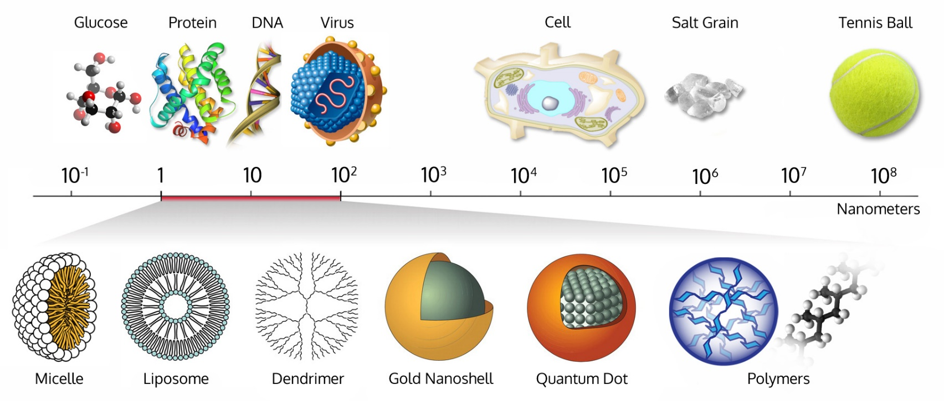
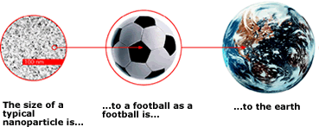
Nanoparticles and exposure
In nanotechnology, a particle is defined as a small object that behaves as a whole unit with respect to its transport and properties. Particles are further classified according to diameter. Coarse particles cover a range between 2,500 and 10,000 nanometers. Ultrafine particles, or nanoparticles, are between 1 and 100 nanometers in size. The properties of many conventional materials change when formed from nanoparticles. This is typically because nanoparticles have a greater surface area per weight than larger particles which causes them to be more reactive to some other molecules.
Nanoparticle research is currently an area of intense scientific research, due to a wide variety of potential applications in biomedical, optical, and electronic fields.

Slide 3
Nanoparticles can be divided into two major categories:
Non-engineered particles
Free/ in aerosol
Engineered particles
Biopersistent
Catalytically active

Slide 4
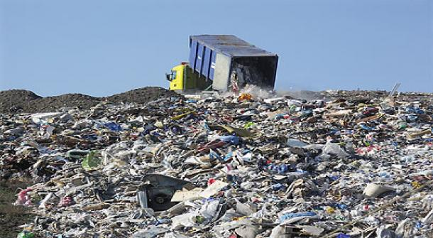
Everyday life and exposure…
Workers
Consumers
Human Exposure/
Consequences
Raw material production
Consumer Product Manufacturing
Consumer Use
Industrial Emissions
Landfills
Ecological Exposure

Slide 5
Why can nanomaterials be toxic?
Two primary factors cause nanomaterials to behave significantly differently than bulk materials: surface effects and quantum effects. These factors affect the chemical reactivity of materials, as well as their mechanical, optical, electric, and magnetic properties. Compared to microparticles, nanoparticles have a very large surface area and high particle number per unit mass. As the material in nanoparticulate form presents a much larger surface area for chemical reactions, reactivity is enhanced roughly.
Nanotoxicology is a branch of bionanoscience which deals with the study and application of toxicity of nanomaterials. Nanomaterials, even when made of inert elements like gold, become highly active at nanometer dimensions. Nanotoxicological studies are intended to determine whether and to what extent these properties may pose a threat to the environment and to human beings.

